Slide 1
B4&AFTER
User Story
Test Plan
Caprice WIlliams, Christelle Flores, Loki SImeon, Kenvin Couilliard

Slide 2
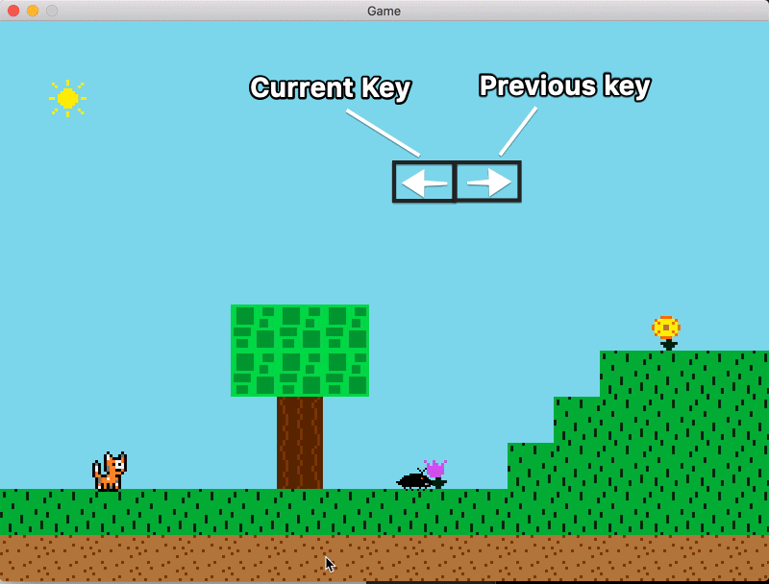
Previous Key OverriDe: User Story
B4&AFTER
As a user I shouldn’t be able to override my previous key at any point.

Slide 3
Previous Key OverriDe: Test Plan
B4&AFTER
Step | Action | Expected Outcome | Pass (✓/X)
1 | Use the arrow keys to move the character in each direction. | The character moves in the direction of the arrow key pressed. | ✓
2 | Press (hold) two arrow keys at the same time to move in two directions at once. (i.e. down & left/right) | The character moves in both directions of the arrow keys pressed at the same time. (i.e. crouch walk left/right) | X
3

Slide 4
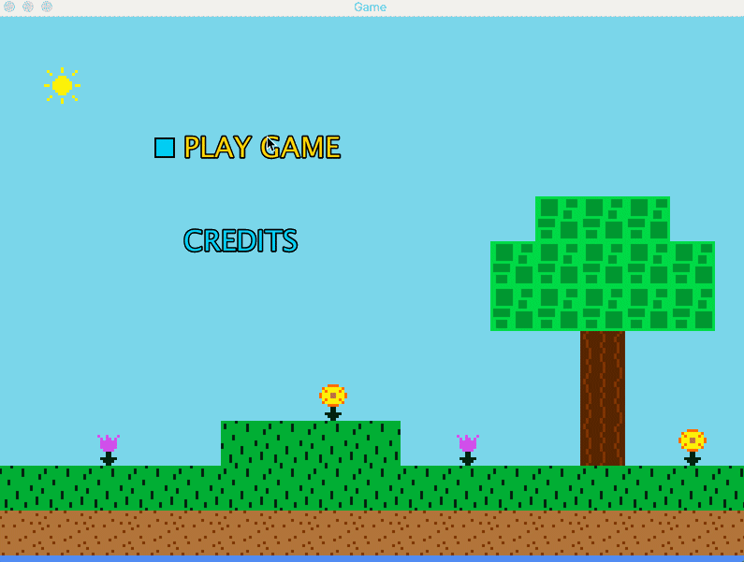
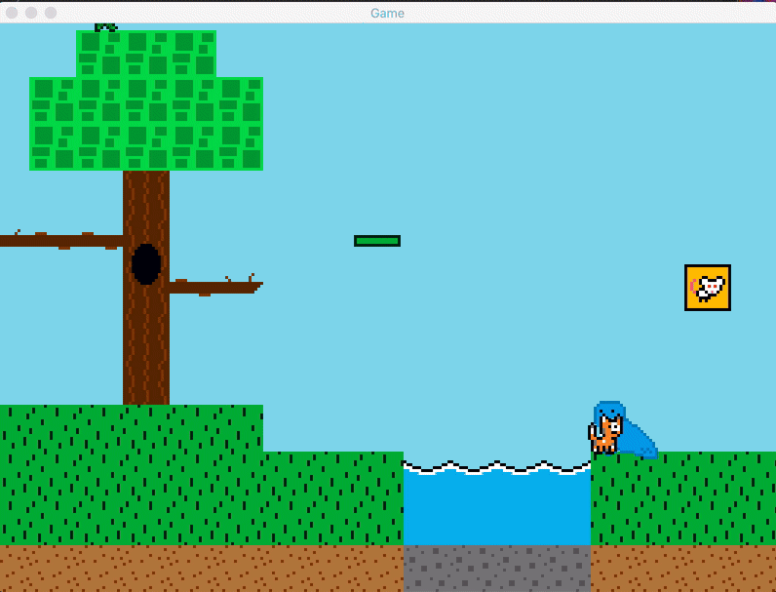
Setting Boundaries: User Story
B4&AFTER
As a player I shouldn't be able to walk off of the games map at any point.

Slide 5
B4&AFTER
Step | Action | Expected Outcome | Pass (✓/X)
1 | On Each level, move the character to the right edge of the screen. | The character will be unable to walk any further and will be stuck in a walking motion with no movement. | X
2 | On Each level, move the character to the left edge of the screen. | The character will be unable to walk any further and will be stuck in a walking motion with no movement. | X
Setting Boundaries: Test Plan

Slide 6
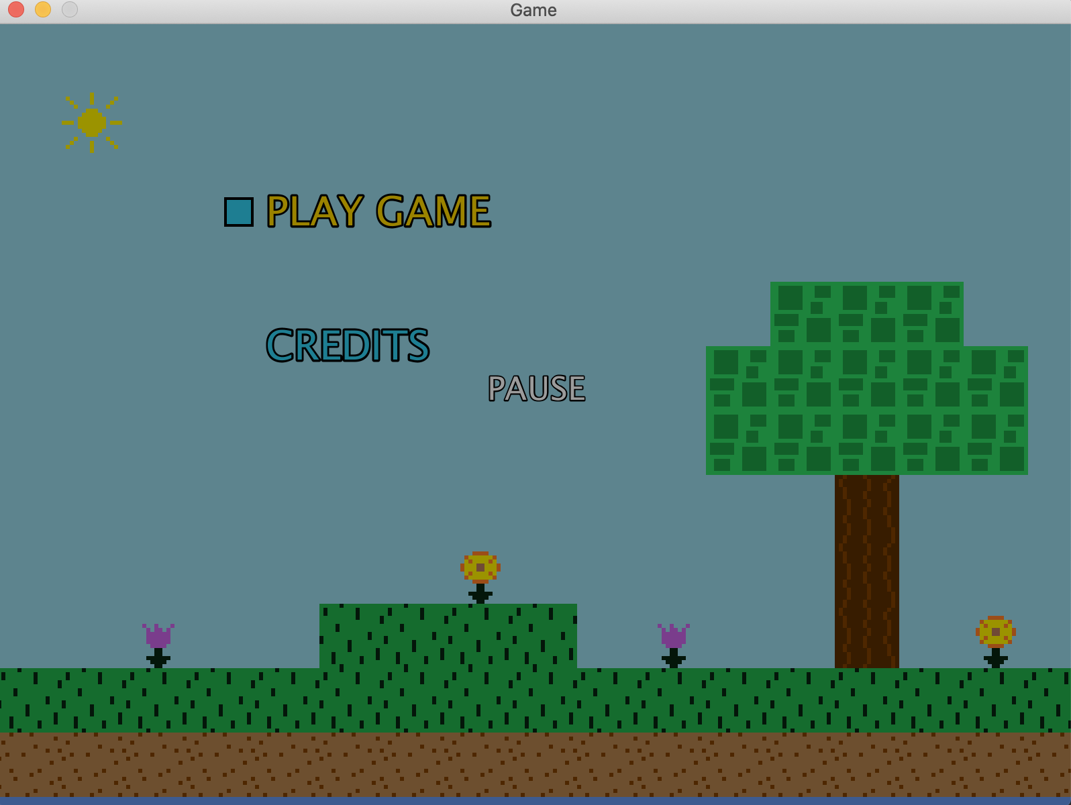
Prevent Pause Screen in Main Menu: User story
B4&AFTER
As a player, I should not be able to pause the game in the opening menu.

Slide 7
B4&AFTER
Step | Action | Expected Outcome | Pass (✓/X)
1 | Open the game to the main menu. | The game window should be as normal. | ✓
2 | Press the P key. | The game state should be unchanged. | X
3 | Begin the game, then press P again. | The game should be paused. | ✓
4 | Have the cat be defeated, then press P again. | The game should ignore the P press and keep processing the game over state. | X
Prevent Pause Screen in Main Menu: Test Plan

Slide 8
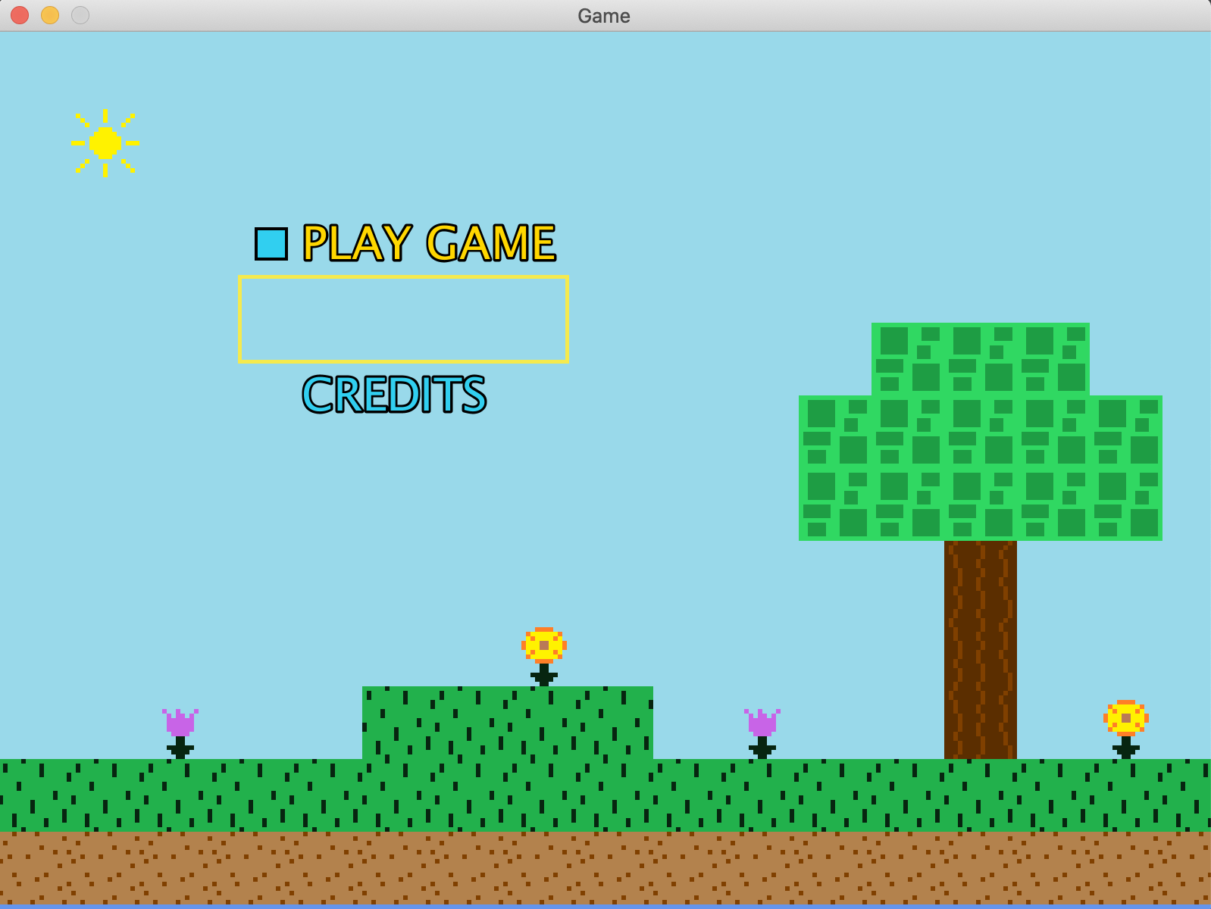
Instructions: User Story
B4&AFTER
As a Player, I want instructions in the main menu, so that I may know what controls are accessible in order to play the game before starting.

Slide 9
B4&AFTER
1 | View the main menu when running the program. | Players should be able to see an “Instructions” option on the main menu along with “Play Game” and “Credits”. | X
2 | Navigate the main menu and be able to select the “Instructions” option. | Players can select the “Instructions” option and when selected, controls/instructions of how to play are displayed on the screen. | X
3 | Read Instructions | Instructions are simple and easy to understand. | X
Instructions: Test Plan

Slide 10

Adjusting WIndow: User Story
B4&AFTER
As a player of the game, I should be able to resize the game window so that I can fill more or less of my screen and see the game better.

Slide 11
B4&AFTER
Step | Action | Expected Outcome | Pass (✓/X)
1 | With the game window open, attempt to grab one of its corners and drag outwards. | The game window becomes larger. | X
2 | With the game window open, attempt to grab one of its corners and drag inwards. | The game window becomes smaller. | X
3 | Click the full-screen button atop the game window. | Rather than being greyed out, the button should function and make the game window fill the screen. | X
Adjusting WIndow: Test Plan

Slide 12
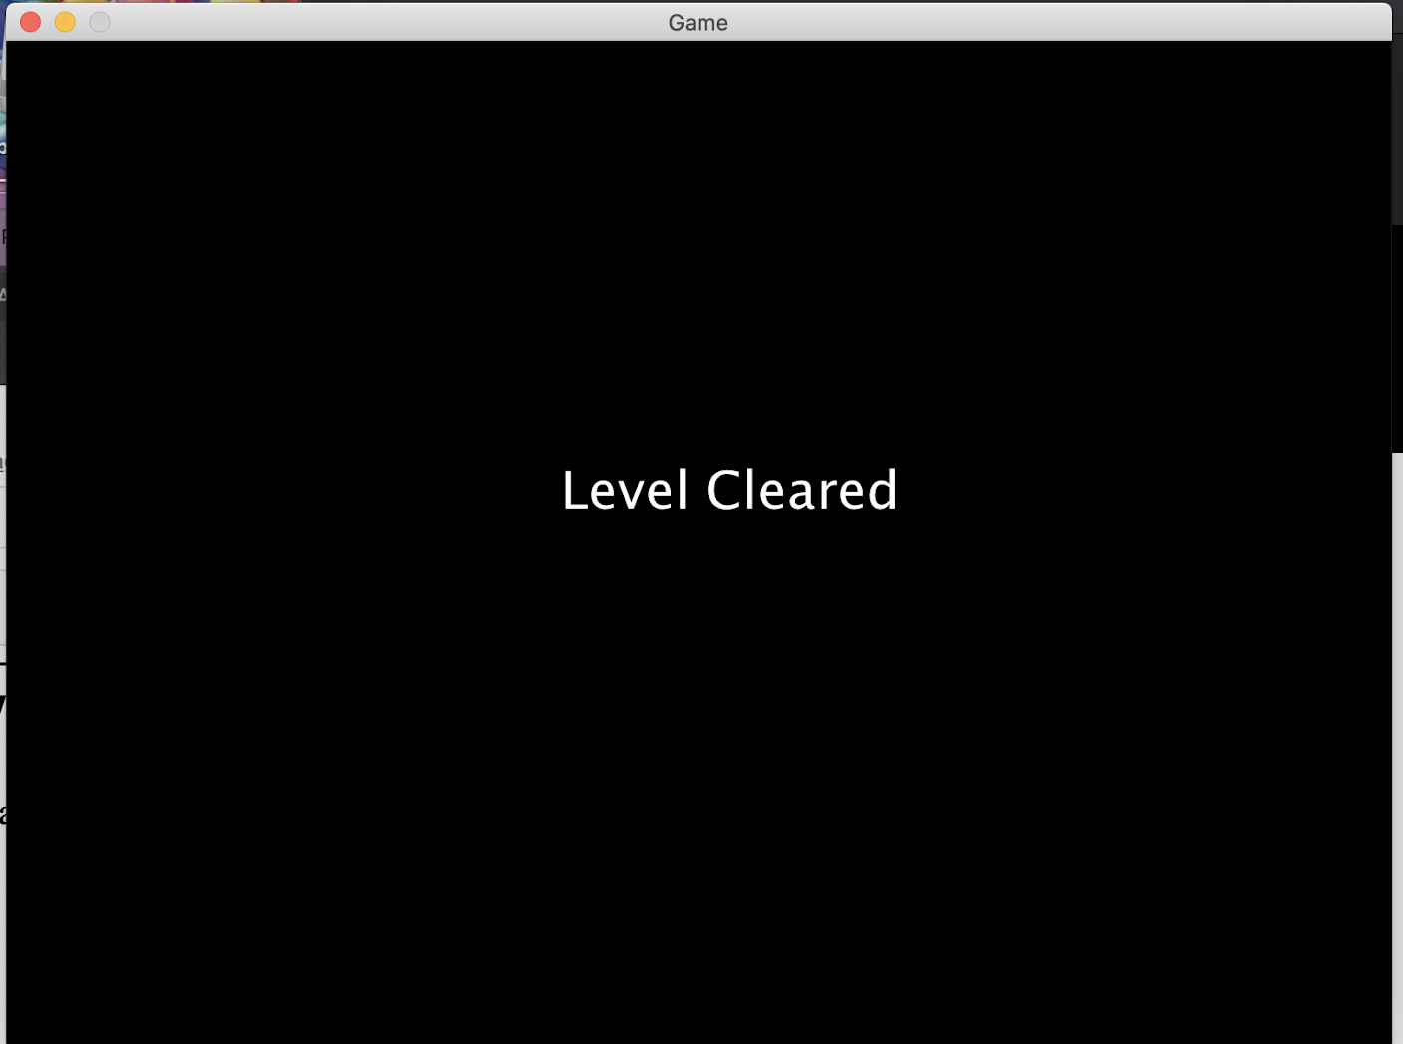
More Levels: User Story
B4&AFTER
As a player I want to be able to test my skill in a series of levels that progressively become harder.

Slide 13
B4&AFTER
1 | Complete Level 1. | Players should see a new level (Level 2) available to play on the screen after completing the first one. | X
2 | Navigate through the next level. | Players should be able to play the next level, similar to the previous one, but with different obstacles/challenges. | X
3 | Complete the entire game. | Players are able to play through a total of 5 levels. After the final level is completed, players would see a “Game Over” screen followed by end credits. | X
More Levels: Test Plan

Slide 14

Attack Method: User Story
B4&AFTER
As a player I want to have some sort of method for attacking and defeating enemies.This will keep me more engaged and satisfied.

Slide 15
B4&AFTER
Step | Action | Expected Outcome | Pass (✓/X)
1 | Interact with an enemy. (i.e. move into it) | The character dies/is defeated and falls off screen. | ✓
2 | Attempt to defeat the enemy. (i.e. jump on top of enemy) | The enemy is defeated and falls off the screen. | X
Attack Method: Test Plan

Slide 16


Main Menu Mouse: User STory
B4&AFTER
As a player I should be able to use my mouse to start the game.

Slide 17
B4&AFTER
Step | Action | Expected Outcome | Pass (✓/X)
1 | Select “play game” with the space key on the main menu. | The game begins at the beginning of the first level. | ✓
2 | Select “play game” with the mouse and left click on the main menu. | The game begins at the beginning of the first level. | X
Main Menu Mouse: Test Plan

Slide 18
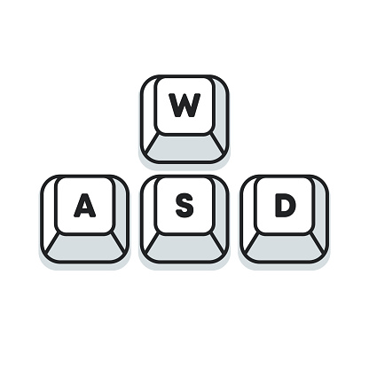
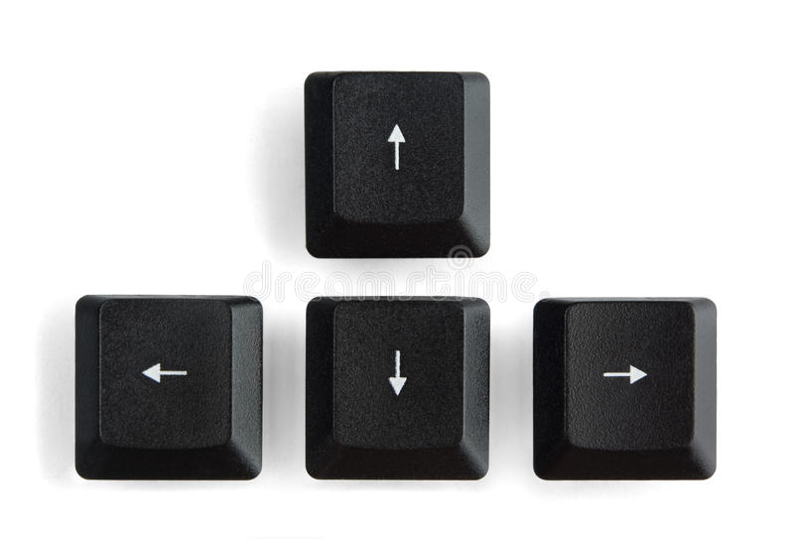
WASD Keys: User Story
B4&AFTER
As a player, I should have another option of controls other than the arrow keys. The WASD keys allow for more gaming versatility.

Slide 19
B4&AFTER
Step | Action | Expected Outcome | Pass (✓/X)
1 | Use the arrow keys for mobility. | The character will move left, right, up and down (crouch) using their respective arrow keys. | ✓
2 | Use the W, A, S, and D key for mobility. | The character will move left, right, up and down (crouch) as they would with the arrow keys. | X
WASD Keys: Test Plan

